Slide 1

You Tube Songs Analysis
Using Power BI
- By Ankita Dey

Slide 2




CONTENT
01
INTRODUCTION
02
DATASET DESCRIPTION
03
PROJECT OBJECTIVES
04
POWER BI DASHBOARD
05
RECOMMENDATIONS
06
CONCLUSION

Slide 3

Introduction
The project aims to conduct a comprehensive analysis of YouTube songs data using Power BI. The dataset contains key attributes such as video ID, channel title, title, description, tags, published date,
view count, like count, favorite count, comment count, video duration, video definition, and caption details. The goal is to utilize Power BI to create insightful visualizations and reports that provide a deeper
understanding of YouTube songs' performance, popularity, and user engagement. The analysis aims to uncover trends, preferences, and patterns in the data to aid content creators and stakeholders in
optimizing their YouTube song content.

Slide 4

DATASET DESCRIPTION:
1. video_id: Unique identifier for each YouTube video.
2. channelTitle: Title of the YouTube channel publishing the song.
3. title: Title of the YouTube song video.
4. description: Description provided for the YouTube song video.
5. tags: Tags associated with the YouTube song video.
6. publishedAt: Date and time when the YouTube song video was published.
7. viewCount: Number of views received by the YouTube song video.
8. likeCount: Number of likes received by the YouTube song video.
9. favoriteCount: Number of times the YouTube song video has been marked as a favorite.
10. commentCount: Number of comments posted on the YouTube song video.
11. duration: Duration of the YouTube song video.
12. definition: Video definition or quality (e.g., HD, SD).
13. caption: Availability of captions for the YouTube song video.

Slide 5

Project Objectives:
Data Cleaning and Preparation:
Exploratory Data Analysis (EDA):
Content and Channel Analysis:
Clean and preprocess the dataset, handling missing values or outliers.
Convert relevant columns to appropriate data types.
Explore patterns and distributions in view counts, like counts, and comments.
Identify trends in the popularity and engagement of YouTube song videos.
Analyze the distribution of videos across different channels.
Identify popular tags and their correlation with view counts.

Slide 6
Project Objectives
User Engagement Insights:
Temporal Trends:
Explore how YouTube song video metrics vary over time.
Identify peak publishing times and their impact on engagement.
Investigate relationships between likes, comments, and views.
Identify factors influencing user engagement with YouTube song videos.

Slide 7

Power BI Dashboard

Slide 8
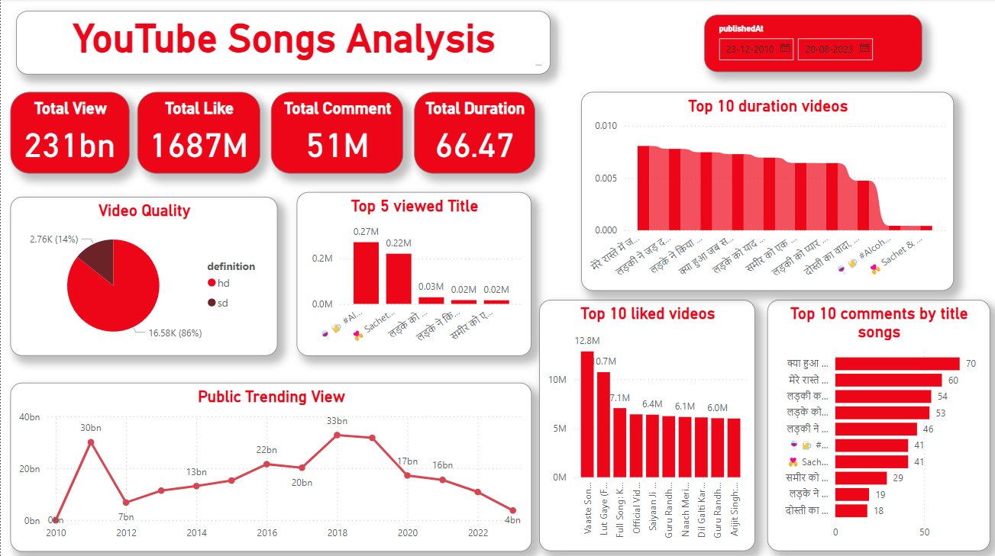

Slide 9

Recommendations:
Identify which songs have the highest number of views, likes, and comments. This helps to understand audience preferences and trending content.
Increase engagement rates by analyzing which types of content (lyric videos, live performances, etc.) generate the most likes, comments, and shares.
Consider creating interactive content such as polls, quizzes or challenges related to popular songs to boost viewer interaction.
Collaborate with other artists, influencers, or brands to expand audience reach and increase engagement.
Track views and engagement over time to identify peak periods, viral trends and long-term popularity trends for songs and artists.

Slide 10





CONCLUSION
Analyzing YouTube songs through comprehensive data analysis reveals valuable insights into audience engagement, content performance, and strategic opportunities for growth. By examining metrics such as views, likes, comments, we gain a deeper understanding of which songs resonate most with viewers and which artists command the most attention. This analysis enables us to identify trends over time and optimize content strategy accordingly.

Slide 11

Thank you

